Slide 1


Titolo presentazione sottotitolo
Middleware projects 2020
Alessio Russo, Carmelo Valore
08/09/2020
Milano, XX mese 20XX

Slide 2
OpenMP – MPI project
Parallelization done both thread-level (OpenMP) and process-level (MPI)
Code divided into 5 main sections:
Setup and reading operations
Query 1
Query 2
Query 3
Free of data structures used
Benchmarks in a cloud cluster

Slide 3
OpenMP – MPI: Setup and reading operations
Global MPI data structures setup and MPI-Datatype definitions
Number of threads setup through command line
Database divided equally among all processes for reading:
Every process knows which part of the file to read
Every process creates threads to parallelize the processing of the tuples of its section
Exchange of useful preliminary information for queries among all processes

Slide 4
OpenMP – MPI: Query 1 Number of lethal accidents per week throughout the entire dataset
Direct access elaboration through the creation of an array, in which the i-th position corresponds to the i-th week
Each process creates its local array of lethal accidents per week
Each process scans its local part of the database, populating the array
MPI_Reduce to let the root process obtain a «global» version of the array which will be the result of the query
Note: OpenMP is not used in this query, since we had to use locks due to race conditions issues, but perfomances were highly worse

Slide 5
OpenMP – MPI: Query 2 Number of accidents and percentage of number of deaths per contributing factor in the dataset
Support list with nodes indicating for each contributing factor the useful information for the query
Each process has its own support list that populates scanning its part of dataset
To parallelize the union of the information by all processes, we firstly inform the root process of the found contributing factors so that it can broadcast to everyone. Finally a MPI reduction is done to have the result of the query
Note: we assumed that factors in the db are provided without “holes”

Slide 6
OpenMP – MPI: Query 3 Number of accidents and average number of lethal accidents per week per borough
Double support list with nodes indicating for each borough for each date, the useful information for the query
Each process has its own support list that populates scanning its part of dataset
It populates, scanning the tuples, an array indexed by week with the information needed. This part of processing is parallelized using OpenMP tasks
To parallelize the union of the information by all processes, we firstly inform the root process of the found boroughs so that it can broadcast to everyone. Finally a reduction is done to have the result of the query

Slide 7
OpenMP – MPI: Benchmarks
We made our benchmarks running on Amazon EC2 cluster, with starcluster. The machine used has 4 cores and 16 GB of RAM memory
We tested our code with the given database and with the same replicated 4 times and 8 times
Also serial performaces are measured, so to be able to make a comparison to see how much parallelization impacts
Comparisons are made between 2 threads and 4 threads, 2 processes and 4 processes; for 4 and 8 times the db also with 8 processes

Slide 8
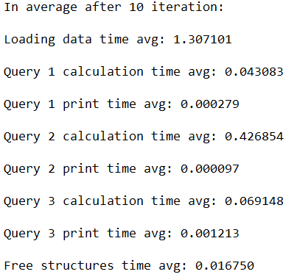
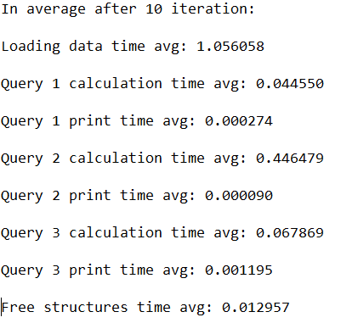
OpenMP – MPI: Benchmarks
Thread comparisons, db x 1, 2 processes
2 threads vs 4 threads

Slide 9
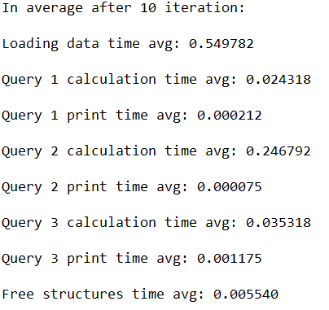
OpenMP – MPI: Benchmarks
Process comparisons, db x 1, 4 threads
2 processes vs 4 processes

Slide 10
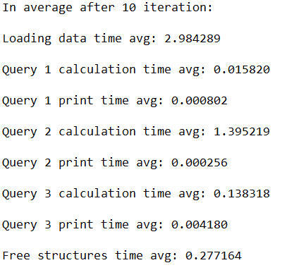
OpenMP – MPI: Benchmarks
Serial performances vs Best case, db x 1
serial vs 4 processes, 4 threads

Slide 11
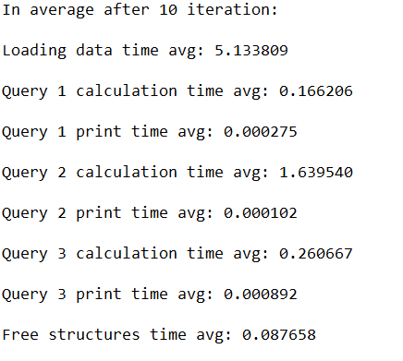
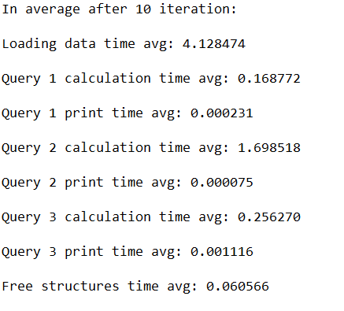
OpenMP – MPI: Benchmarks
Thread comparisons, db x 4, 2 processes
2 threads vs 4 threads

Slide 12
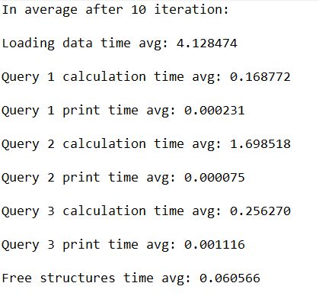
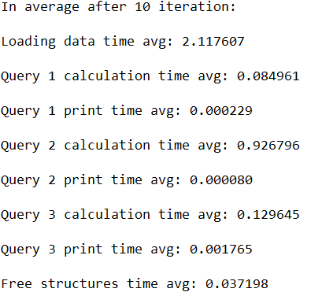
OpenMP – MPI: Benchmarks
Process comparisons, db x 4, 4 threads
2 processes vs 4 processes

Slide 13
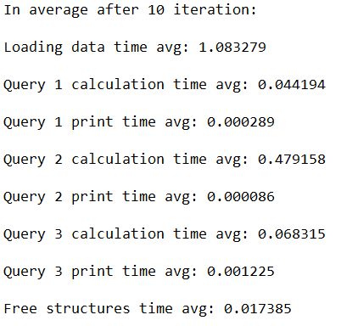
OpenMP – MPI: Benchmarks
Process comparisons, db x 4, 4 threads
4 processes vs 8 processes

Slide 14
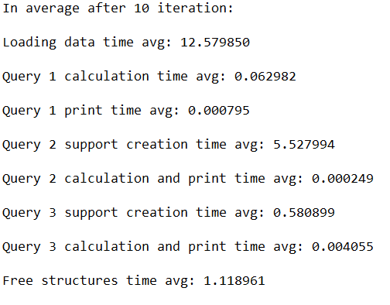
OpenMP – MPI: Benchmarks
Serial performances vs Best case, db x 4
serial vs 8 processes, 4 threads

Slide 15
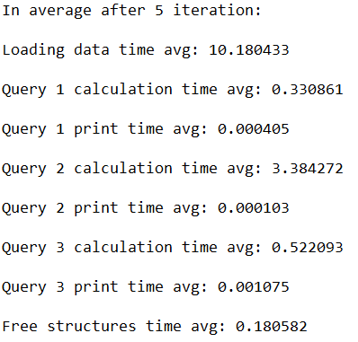
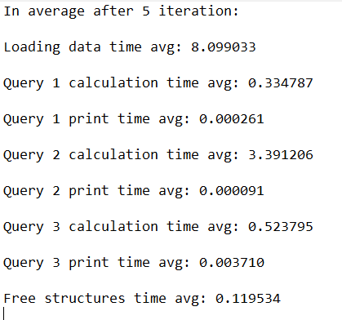
OpenMP – MPI: Benchmarks
Thread comparisons, db x 8, 2 processes
2 threads vs 4 threads

Slide 16
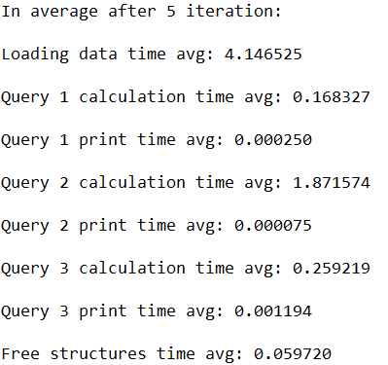
OpenMP – MPI: Benchmarks
Process comparisons, db x 8, 4 threads
2 processes vs 4 processes

Slide 17
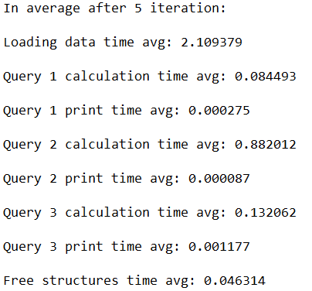
OpenMP – MPI: Benchmarks
Process comparisons, db x 8, 4 threads
4 processes vs 8 processes

Slide 18
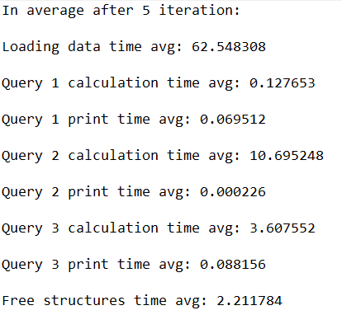
OpenMP – MPI: Benchmarks
Serial performances vs Best case, db x 8
serial vs 8 processes, 4 threads

Slide 19
Spark project
Number of cores and memory usage, tiny executors vs fat executors configuration, set through command line
Code divided into 4 main sections:
Setup and reading operations
Query 1
Query 2
Query 3
Benchmarks in a cloud cluster

Slide 20
Spark project: Setup and reading operations
Setup of configuration (number of cores, memory, ..)
Creation of the table structure with all the fields
Reading from csv
Selection of the only useful columns of the database
Add of a column to summarize all the «killed» ones, find of min and max date through the database using a select on date and min/max aggregate functions to know the considered number of weeks
Table persisted since used most of the time

Slide 21
Spark project: Query 1 Number of lethal accidents per week throughout the entire dataset
Database filtered with predicate #killed > 0, to find tuples related to lethal accidents. Persisted since used as base of all other queries
Map function to map each row of the database to the index of the week it refers to
Aggregate function «count by value» to sum all the accidents happened the same week
Print of the results

Slide 22
Spark project: Query 2 Number of accidents and percentage of number of deaths per contributing factor in the dataset
Support class that associates to each contributing factor the number of accidents
Flat map function to map each row of the database to the tuple <contributing factor name, support class 2>, one for each contributing factor in that row
Database mapped through the previous function by different workers to find for each contributing factor the information needed for the query
Combine-by-key methodology to group the results of each part of the database elaborated by the different workers

Slide 23
Spark project: Query 3 Number of accidents and average number of lethal accidents per week per borough
Two different support classes that associates to each borough the number of accidents for each week
We firstly map each row of the database to the tuple <borough name, support class 3a>, so to have for each row the name of the borough and the index of the week it refers to and the number of lethal accidents
Then we create the combine-by-key functions to map and group the instances of «support class 3a» to another «support class 3b» indicating for each borough for each week the number of lethal accidents. This part is done in parallel by different workers on different part of database, and then combined together to have the result of the query

Slide 24
Spark project: Benchmarks
All benchmarks were done on a cloud cluster with AWS Educate, on machines with 4 cores and 16 GB of RAM limited to around 10 GB per executor
First we tested tiny executor configuration vs fat executor configuration
These two configurations are two «edge case» configurations:
Tiny: there is one core per executor but this do not allow to completely exploits correctly the parallelism due to the overhead caused by the communication of all the executors and the JVM management; a pro is that the throughput may be higher.
Fat: there is just one executor using all the cores provided, also this edge case is not the best solution since it does not leave any resource for the Spark framework overhead and throughput goes down drastically; a pro is that a good parallelism is achieved and there is a low communication overhead

Slide 25
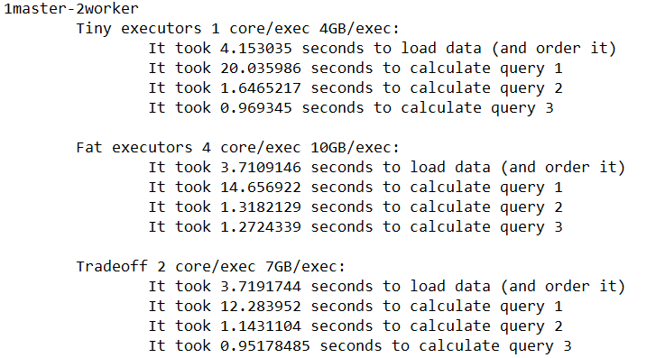
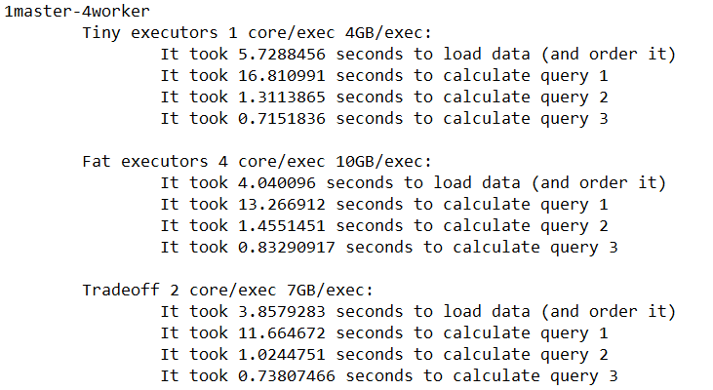
Spark project: Benchmarks
To achieve best of both configurations, we used a balanced solution to exploit parallelism of fat executors and throughput of tiny executors configurations

Slide 26
Spark project: Benchmarks
Said that, we tested on the database provided and replicated 2, 4, 12 and 24 times, since we notice that, differently from OpenMP-MPI, Spark performances were better and better only when database is large enough
Comparisons are done among clusters with increasing size of workers, from 2 up to 6. In the following slide, 2, 4 and 6 workers’ executions are shown with respect to the databases sizes said previously

Slide 27
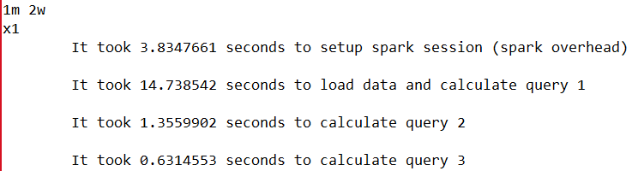
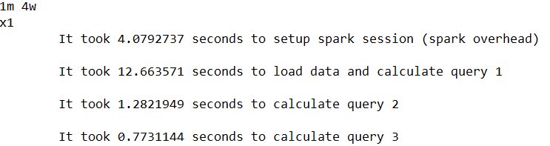
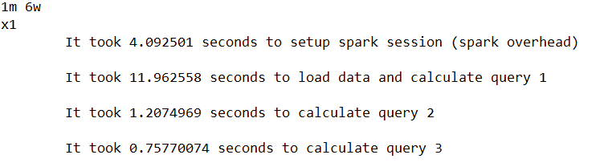
Spark project: Benchmarks
DB x1
1 master 2 workers vs 1 master 4 workers
1 master 4 workers vs 1 master 6 workers

Slide 28
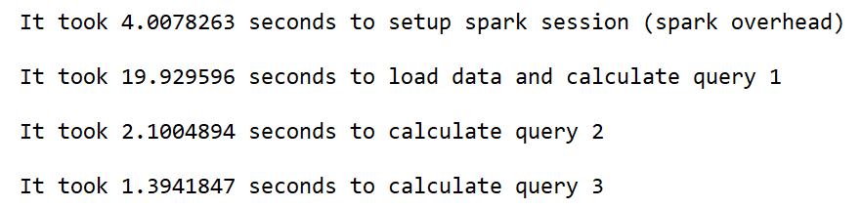
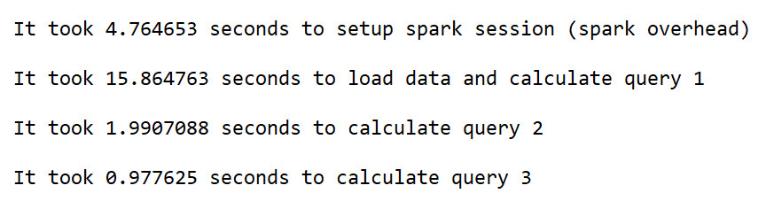
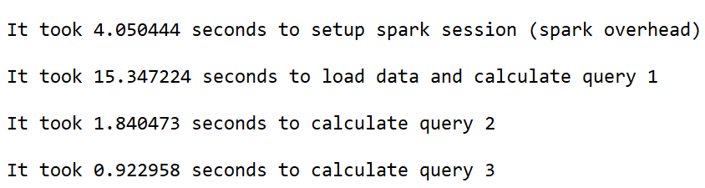
Spark project: Benchmarks
DB x4
1 master 2 workers vs 1 master 4 workers
1 master 4 workers vs 1 master 6 workers

Slide 29
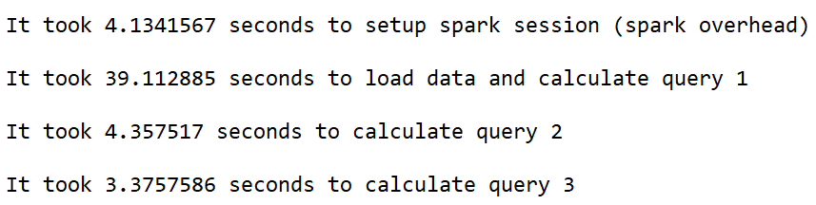
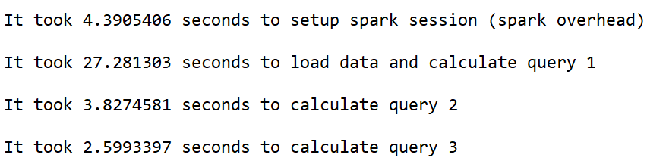
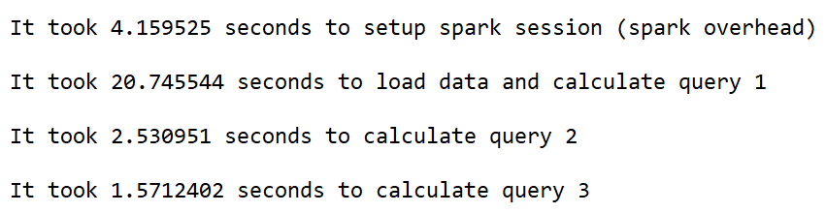
Spark project: Benchmarks
DB x12
1 master 2 workers vs 1 master 4 workers
1 master 4 workers vs 1 master 6 workers

Slide 30
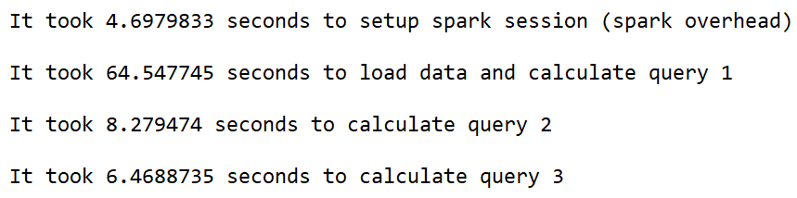
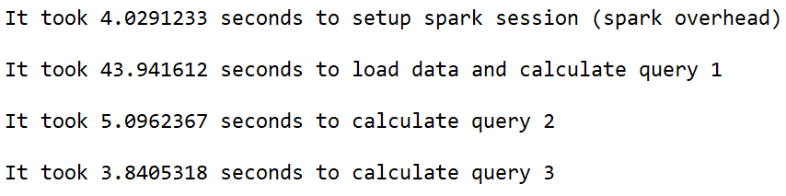
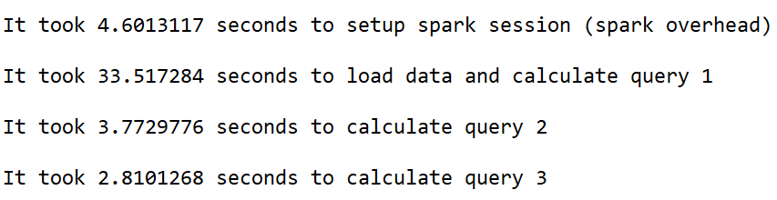
Spark project: Benchmarks
DB x24
1 master 2 workers vs 1 master 4 workers
1 master 4 workers vs 1 master 6 workers

Slide 31
Comparison: Spark – openMP/MPI
Both Spark and OpenMP/MPI are popular frameworks used for parallel computing in the big data scenario
Comparing the results of the benchmarks used to solve the same problem with the two frameworks we can see that:
Spark has an higher setup overhead than OpenMP/MPI
Spark shows more relevant results as the dimension of processed data increases
OpenMP/MPI yields better results compared to Spark

Slide 32
REST project
Image server in which users can register/log in and upload their images. All users can see the images of all other users, but they have to be logged in. The system is provided through a REST-api with HATEOAS (Hypermedia As The Engine Of Application State)
Developed using Spring framework
Based on model-view-controller paradigm
Deployed on Heroku platform using PostgreSQL database
Basic authentication security configuration
«Proof of concept» OAuth2.0 development

Slide 33
REST project - Model
Model is composed of «User» class and «Image» class. «Link» class is created to support and develop HATEOAS. Finally a «Database» to manage connection with PostgreSQL
«User» class contains a unique identifier, a name, a password, and links that will be used to navigate through the endpoints of the service
«Image» class contains a unique identifier, a title, its dimensions and the bytes to save it in the database
«Link» class contains the url of the link and an identifier, called relation, to immediately understand what that link refers to

Slide 34
REST project - Model
The database contains 2 main tables referred to the Resource Server
User table
Image table
uuid (PK) | name | self_link | users_link | images_link | upload_folder_link | home_link
image_uuid (PK) | user_uuid (PK) | title | width | height | picture | user_link | …

Slide 35
REST project - Controller
The REST controller exposes different endpoints to the users of the service
To what regards the User management, we have
/users: with mapping to GET, POST, DELETE (only admin), to respectively get all the users in the system, add a new user, delete all the users of the system. When adding a new user, a name and a password must be provided. The system generates a unique identifier that coupled with the password will be the credentials to use to log in
/users/{id}: with mapping to GET, PUT (only the owner or an admin), DELETE (only the owner or an admin), with meaning as previous; put allows to update name and/or password of the user
To what regards the Image management, the endpoints and the mapping to HTTP CRUD actions are very similar to the one previously said

Slide 36
REST project – Service and View
Two services, one for User management and one for Images
When an endpoint is accessed and a request is done, the services elaborate it and establish a connection to the db to ask for what is necessary. As an example, when a GET on /users is done, the User service does a «SELECT … FROM User» query to the db and gives the result back
The result is then passed to another component, the View, which job is to render the HTML page in a user-friendly way
Also HTML forms are used in order to give the possibility to the user to get or add users/images directly with the front end. Moreover, links to support HATEOAS and the movements between endpoints is rendered in the page for each element
Note: current browsers’ version do not support PUT and DELETE calls directly with Javascript, and no page was opportunely set up since because not deemed significant. To show this calls works, we simply used the Postman app from Google Chrome

Slide 37
REST project – OAuth2.0
OAuth2.0 mechanism was developed to let a client see the images in the server
To implement it, we add several tabales to store and manage clients and users credentials, authorization codes and tokens
The flow implemented is the «authorization code flow».
It is started by the client, that asks for an authorization code to the Authorization server
It redirects the user on the client to a page in which the user must let the client acts on his behalf
If this is the case, the client asks for a token to the Authorization server, that checks all the credentials and if the authorization code provided matches the client and it’s not expired
Finally the user is redirected back on the client that now can asks for images to the Resource server letting it see the token.
In the Resource server, when a GET of images is done and there’s a token in the request, before giving the answer it firstly asks to the Authorization server if the token is correct

Slide 38
REST project – OAuth2.0
No external authorization server or client app were used. They were written from scratch. Since OAuth2.0 is a complex standard, and this was just a «proof of concept»:
Authorization server was implemented following the rfc in the parts deemed significant for the flow to work
Client development and sign in were out of scope of OAuth2.0, thus a very simple and pre-registered client was developed
Despite of these considerations and simplifications, this perfectly shows how the OAuth mechanism works and could be very well expanded in future if needed

Slide 39
Middleware projects 2020
Alessio Russo, Carmelo Valore
08/09/2020

